Slide 1

East Tennessee Mental Health Resources
Help Me Find What I Need!
Welcome to East Tennessee Mental Health Resources.
Submit New
Resource
Search Resources
Search
Filter
Med MGMT
Therapists
Facilities
Student Resources
Resource 1
Resource 2
Admin Login
Resource 3
Resources 1-12

Slide 2
East Tennessee Mental Health Resources
Welcome to East Tennessee Mental Health Resources.
The long rectangle to the right represents a toggle bar function. This toggle bar is slightly scrolled down to reveal a search by address functionality
If you toggle down more, you may search by a zip with a radius
Filter
Student Resources
Search Address
Within 10 Miles
Within 20 Miles
Within 30 Miles
Filter
Search Zip
Within 10 Miles
Within 20 Miles
Within 30 Miles
Enter Zip
Enter Address

Slide 3

East Tennessee Mental Health Resources
Medication Management Providers
Help Me Find What I Need!
Submit New
Resource
Search Resources
Search
Filter
Med MGMT
Therapists
Facilities
Student Resources
Resource 1
Resource 2
Admin Login
Resource 3
Previous Page
Resources 1-12
Next Page

Slide 4
East Tennessee Mental Health Resources
Therapists
Help Me Find What I Need!
Submit New
Resource
Search Resources
Search
Filter
Med MGMT
Therapists
Facilities
Student Resources
Resource 1
Resource 2
Admin Login
Resource 3
Previous Page
Resources 1-12
Next Page

Slide 5
East Tennessee Mental Health Resources
Inpatient Facilities
Help Me Find What I Need!
Submit New
Resource
Search Resources
Search
Filter
Med MGMT
Therapists
Facilities
Student Resources
Resource 1
Resource 2
Admin Login
Resource 3
Previous Page
Resources 1-12
Next Page

Slide 6

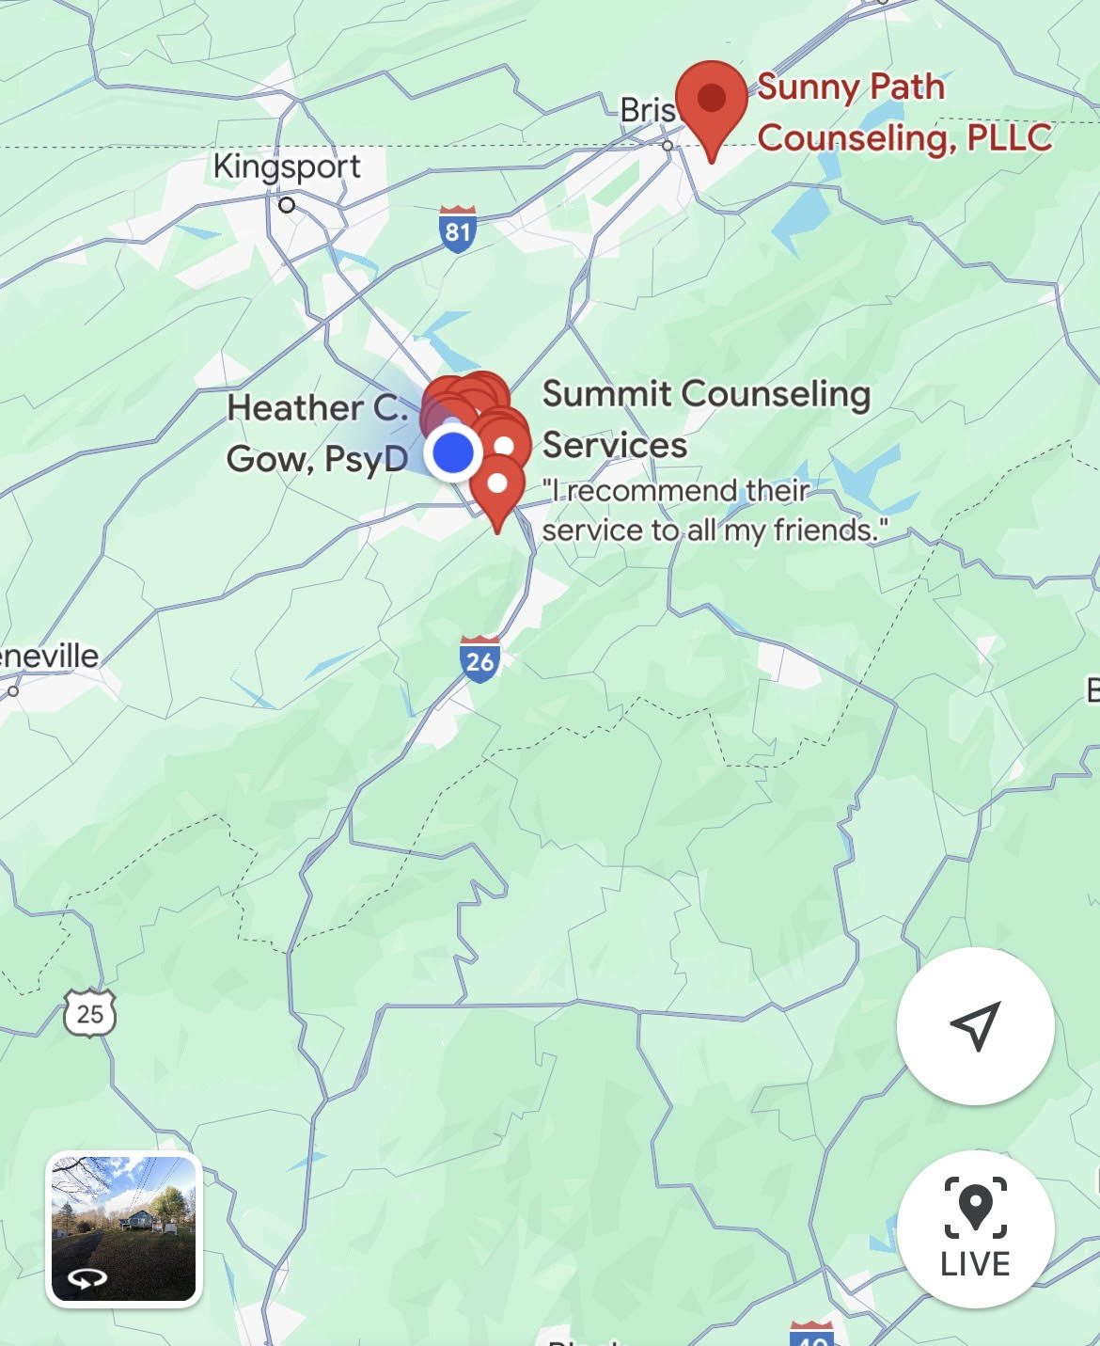
East Tennessee Mental Health Resources
Therapists
Help Me Find What I Need!
Submit New
Resource
Search Resources
Search
Filter
Med MGMT
Therapists
Facilities
Student Resources
Janine Hinkley
Licensed Professional Counselor
Associated Practice: Sunny Paths LLC.
123 Mockingbird Lane, Johnson City, Tennessee
Accepts Insurance: Yes
Insurances Accepted: Cigna, Aetna, BlueCross BlueShield
Phone: 555-555-5555
Admin Login
Back to Search

Slide 7
East Tennessee Mental Health Resources
Submit a New Resource
Back
What type of resource do you want to submit?
Search Resource Types
Search
Submit a Therapist
Search
First Name
Last Name
Therapist
Medication Management
Inpatient Facility
Outpatient Program
Student Related Resource
Address Line 1
Address Line 2
Associated Practice
Accepts Insurance
Yes
No

Slide 8
East Tennessee Mental Health Resources
Submit a New Resource
Back
What type of resource do you want to submit?
Search Resource Types
Search
Submit a Therapist
Search
Associated Practice
Therapist
Medication Management
Inpatient Facility
Outpatient Program
Student Related Resource
Accepts Insurance
Select Specialties
Yes
No
Athletes
Marriage
Students
OCD
GAD

Slide 9

East Tennessee Mental Health Resources
Administrative Login
Log In
Email Address or Username
Password
Log In

Slide 10

East Tennessee Mental Health Resources
Administrative
Submission Requests

